Slide 1
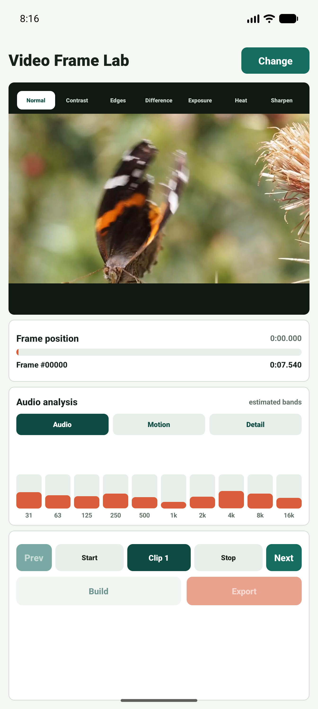
Video Frame Lab
Android/iOS submission feature walkthrough
Frame-by-frame video inspection with preview filters.
Audio, motion, and detail bands for quick review.
Start/stop frame marking, strip building, and export.
First-start disclaimer included for responsible use.
Loaded video analysis
Submission feature screenshots | 1

Slide 2
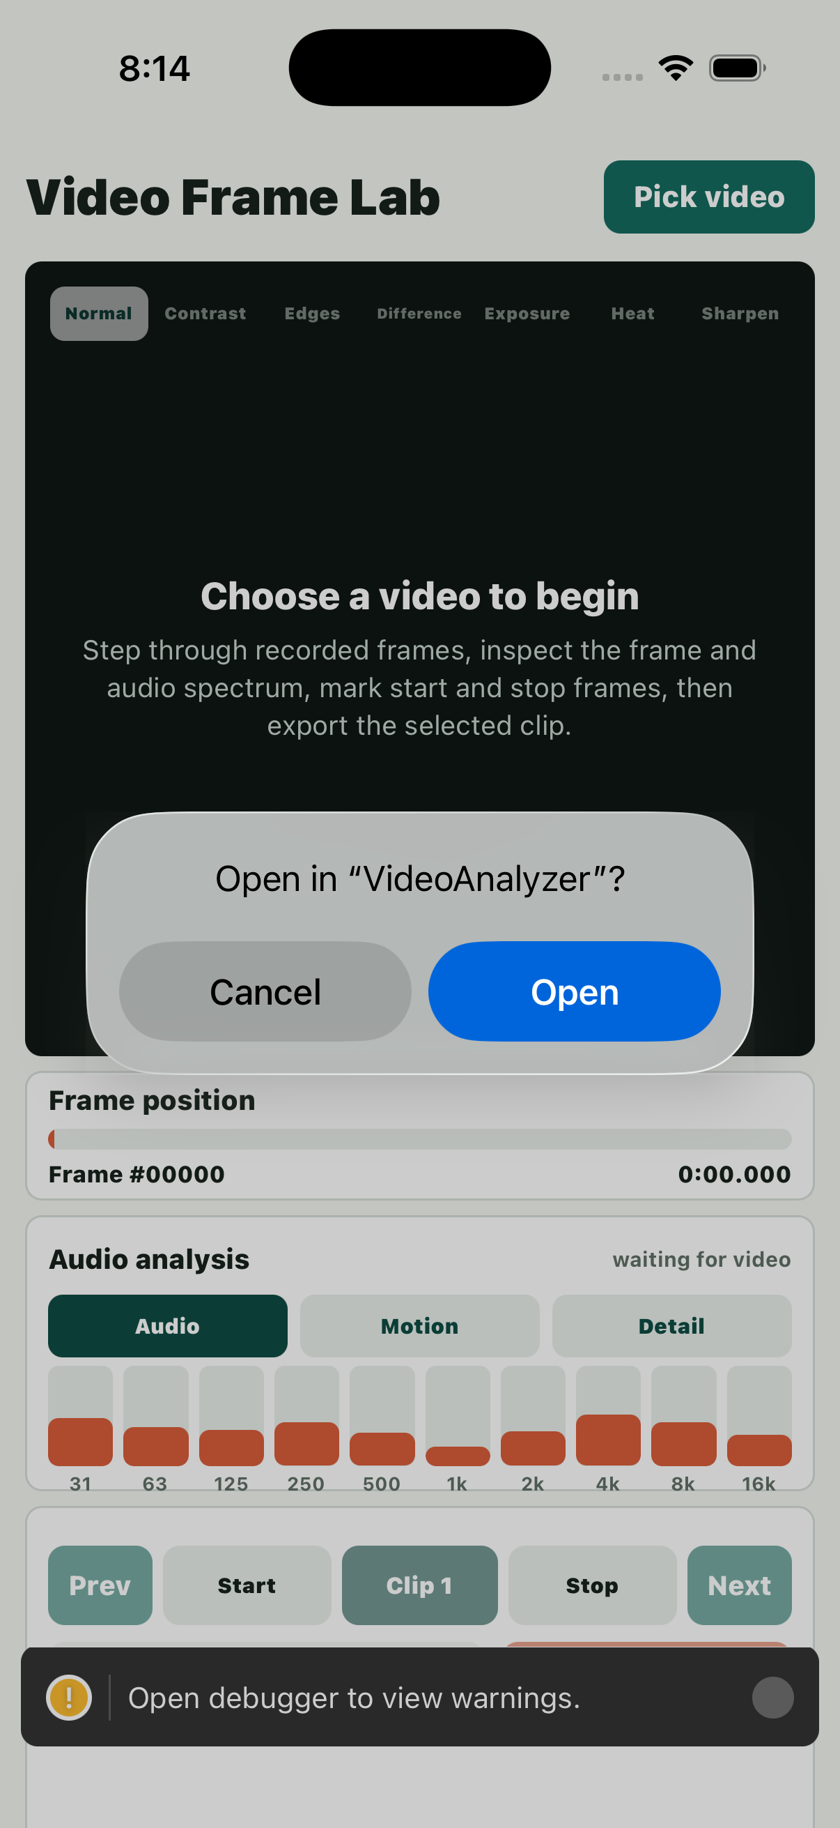
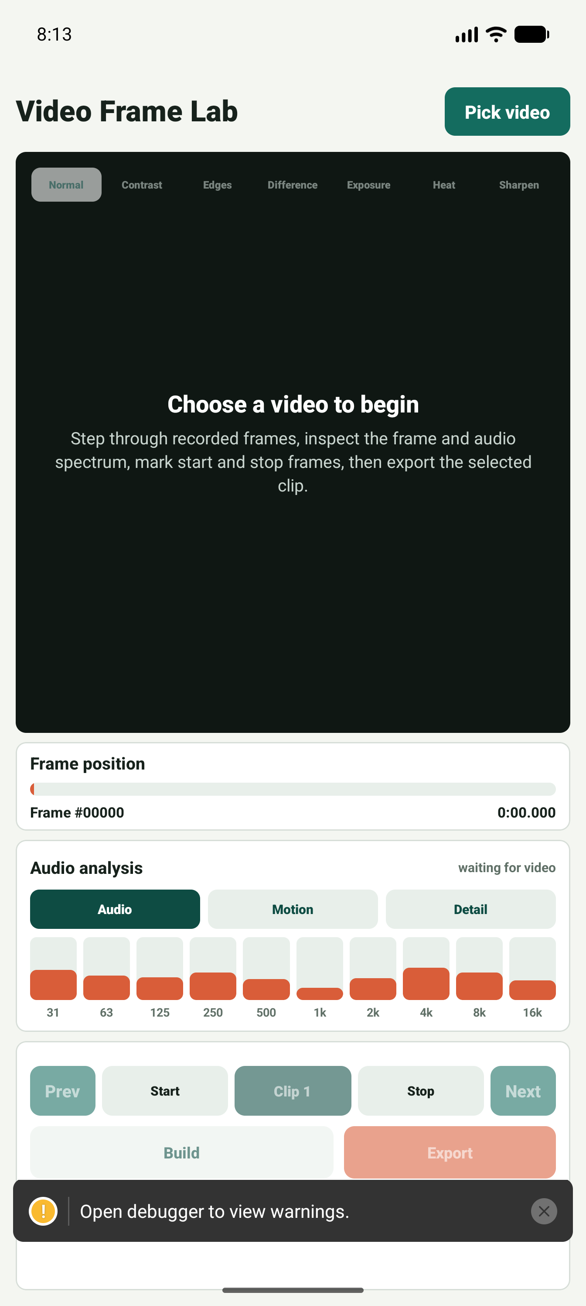
Video Frame Lab
First-start disclaimer appears before use
States that analysis is an editing aid.
Warns against safety-critical, legal, medical, or forensic reliance.
Reminds users to use videos they have permission to edit.
iOS
Android
Submission feature screenshots | 2

Slide 3

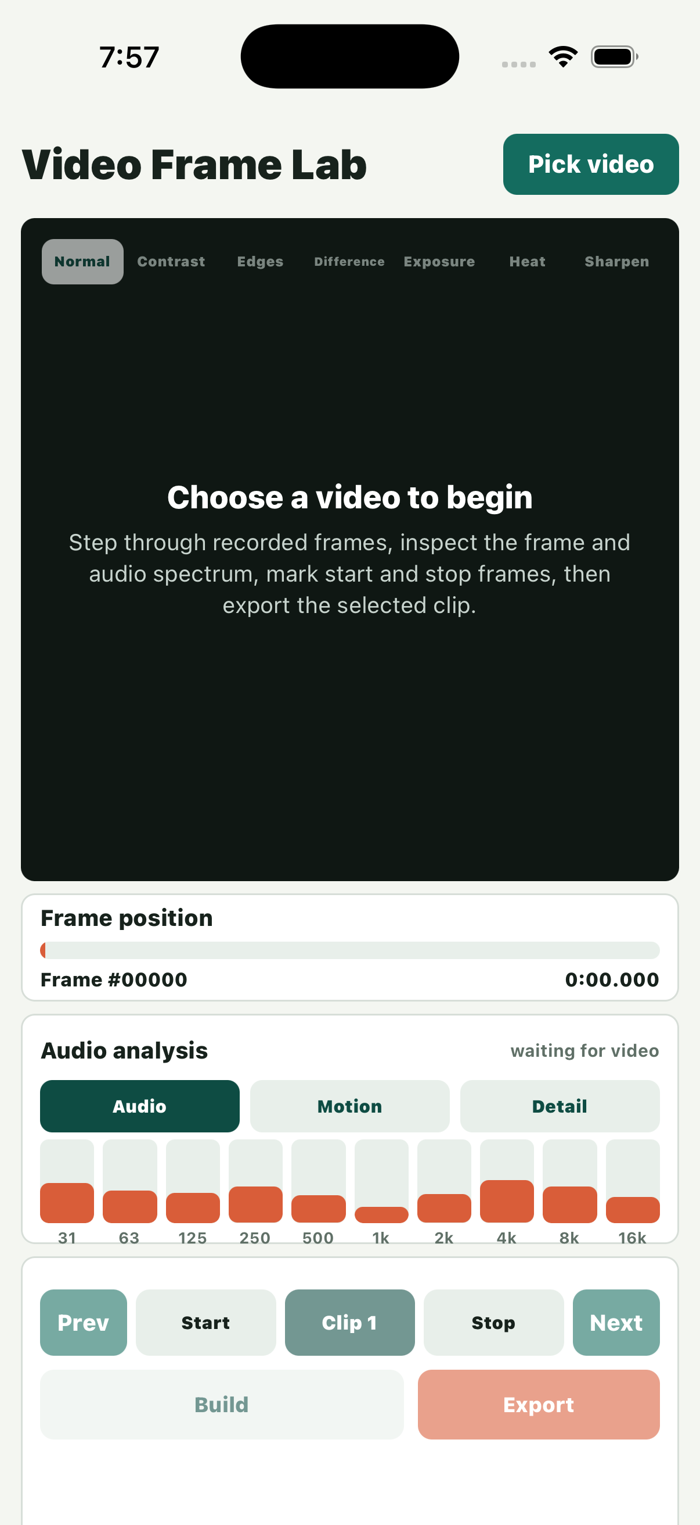
Video Frame Lab
Clean empty state guides the first action
Prominent “Pick video” action.
Preview panel explains the frame-analysis workflow.
Controls are visible but disabled until a video is selected.
Android home
iOS home
Submission feature screenshots | 3

Slide 4
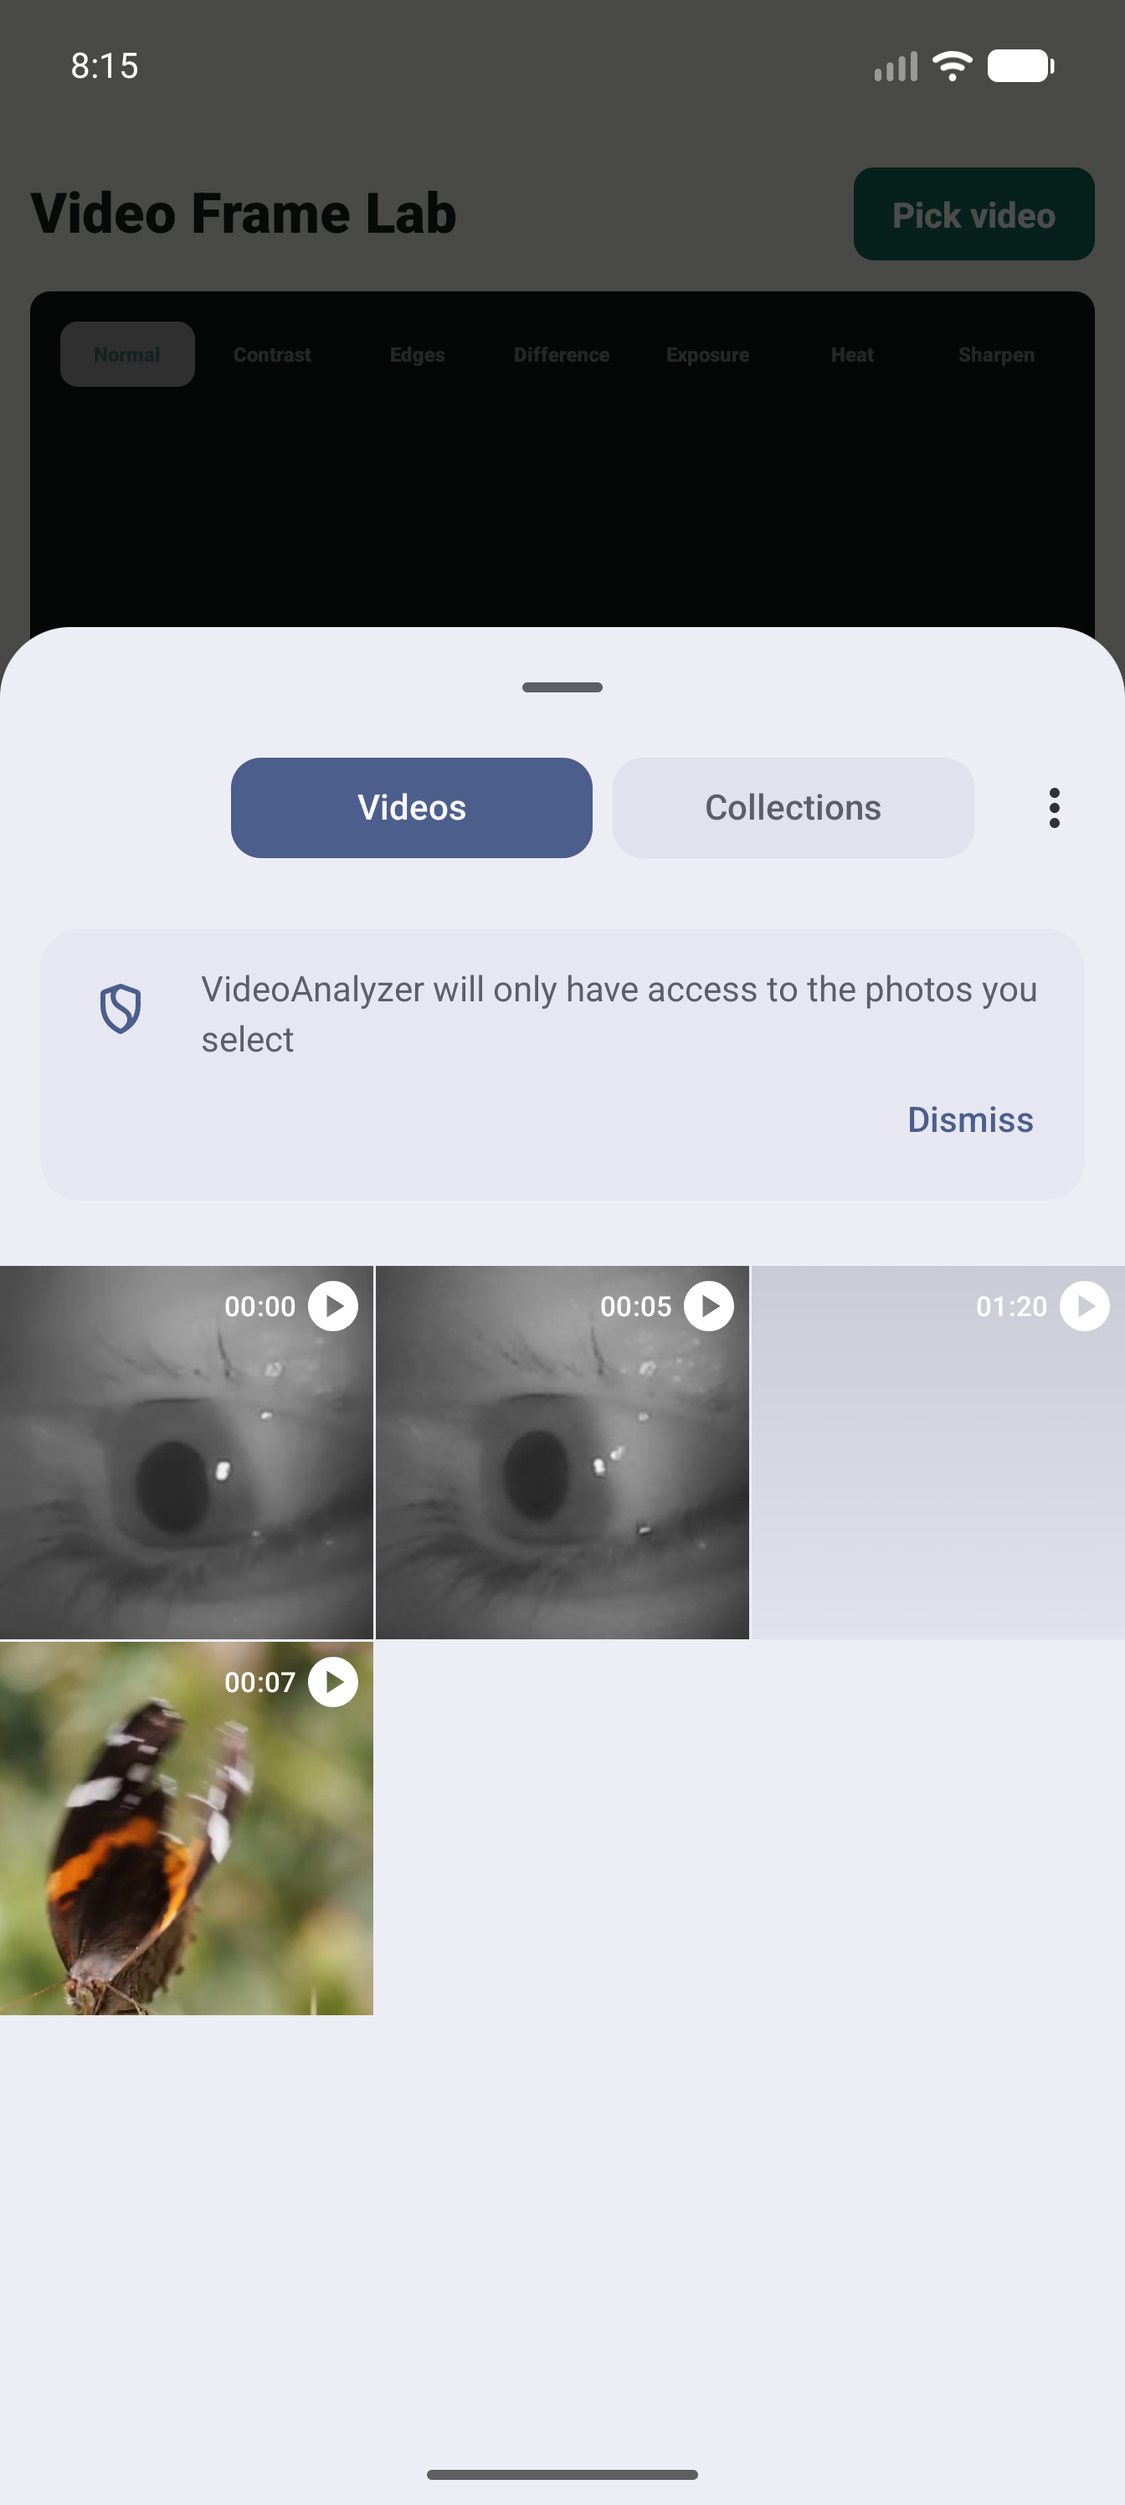
Video Frame Lab
Media picker and selected-video workflow
Uses native media picker access.
Loads a frame preview immediately after selection.
Duration and frame position become active once media is ready.
Video picker
Loaded video
Submission feature screenshots | 4

Slide 5
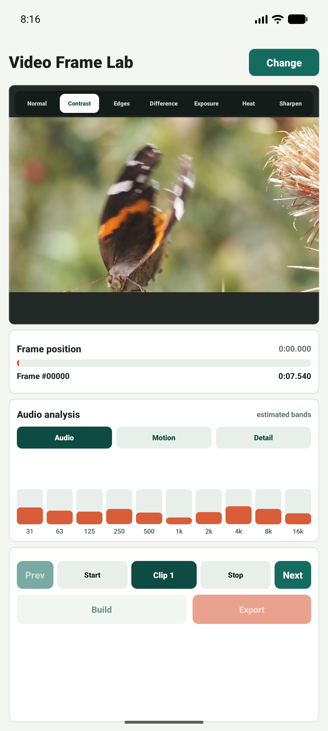
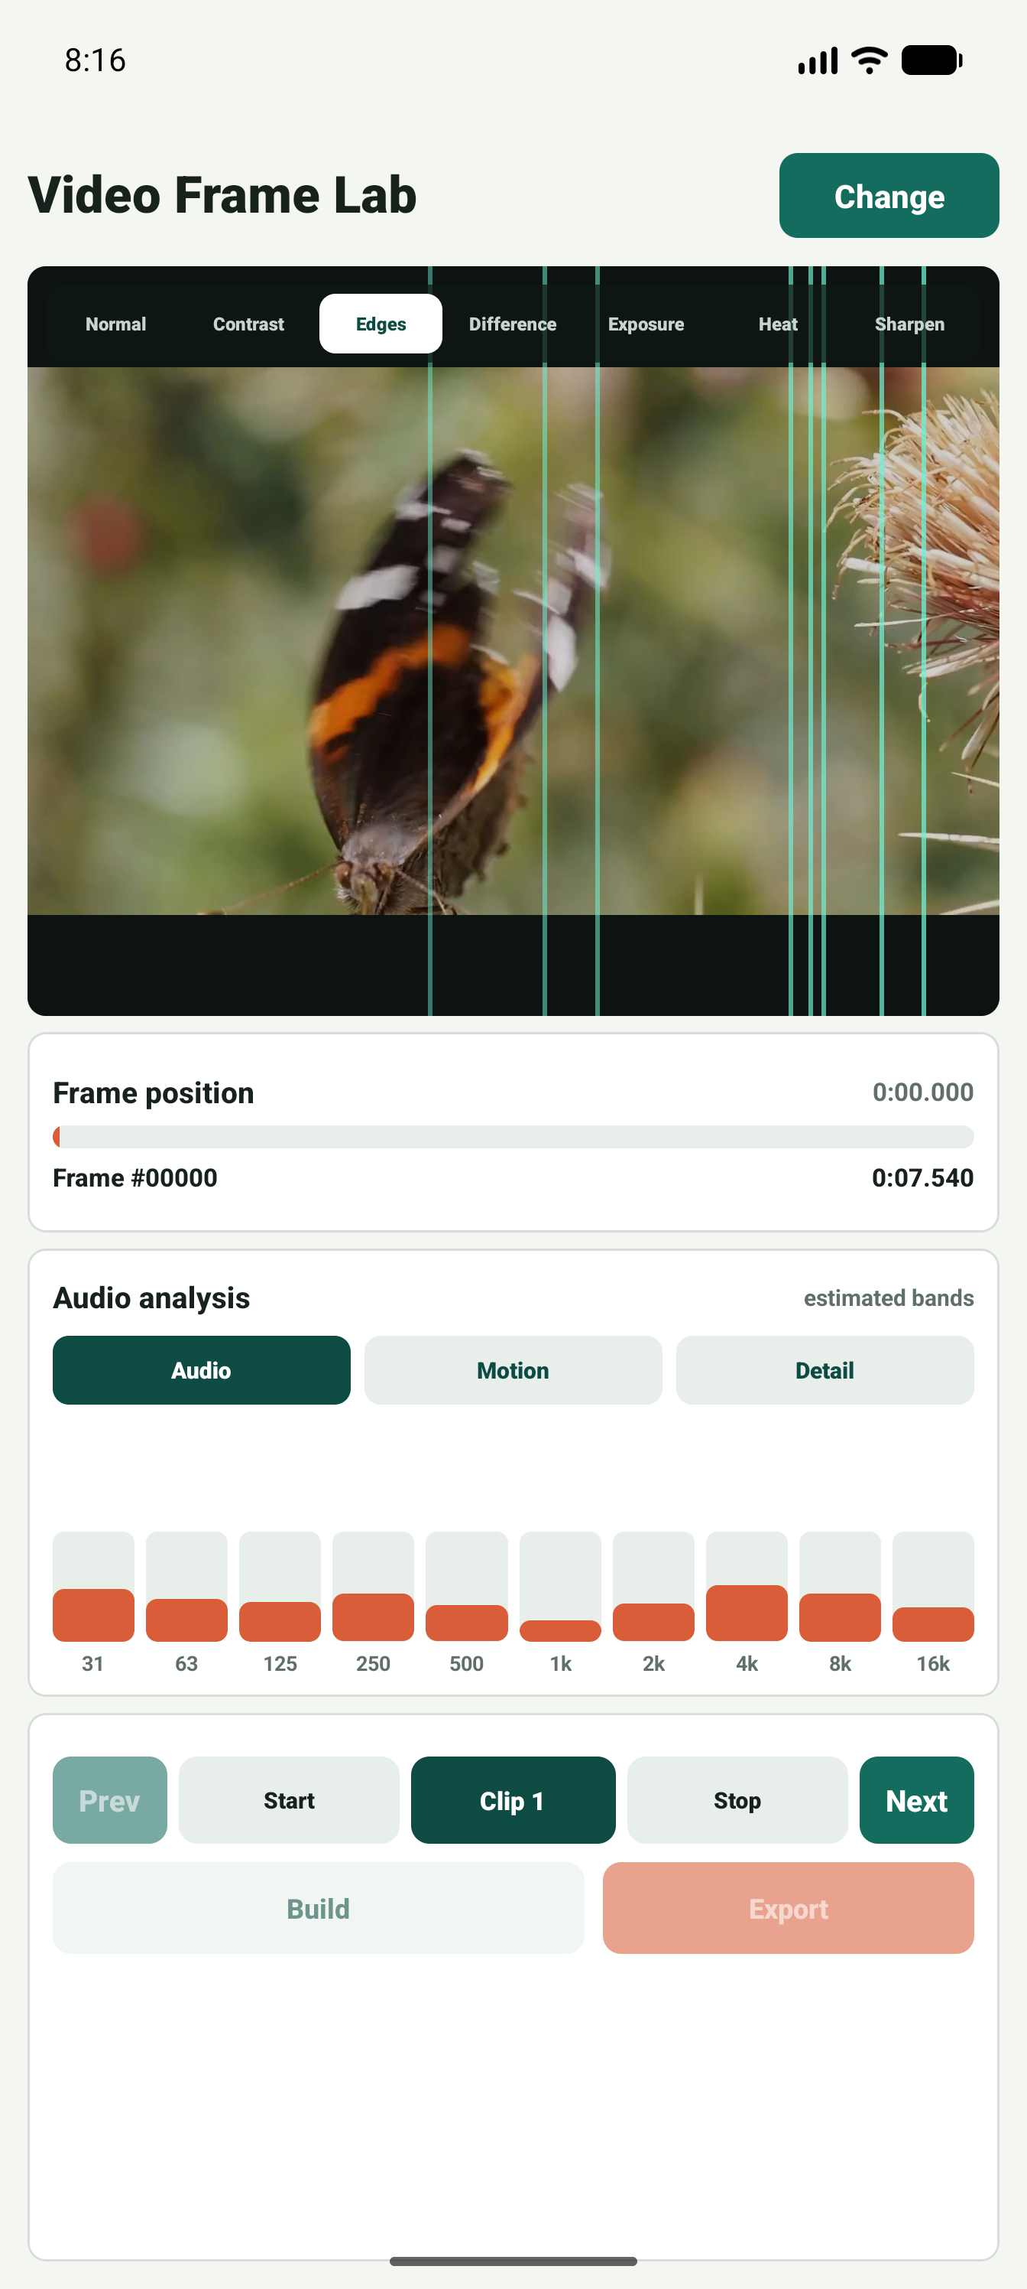
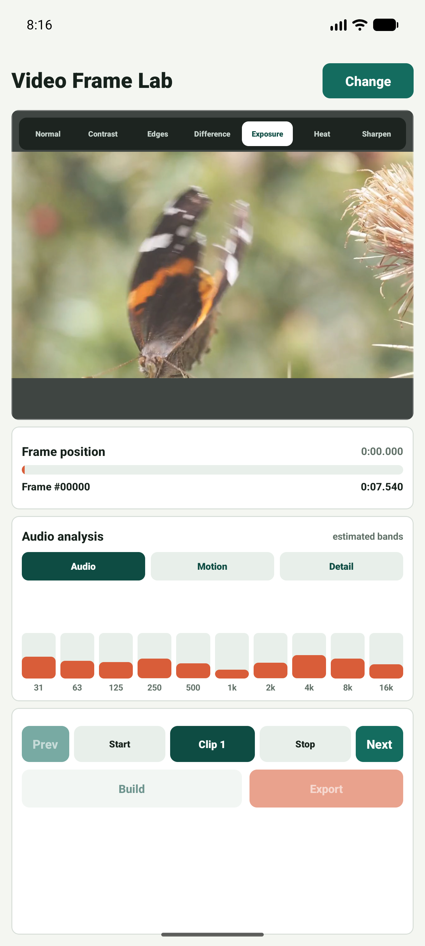
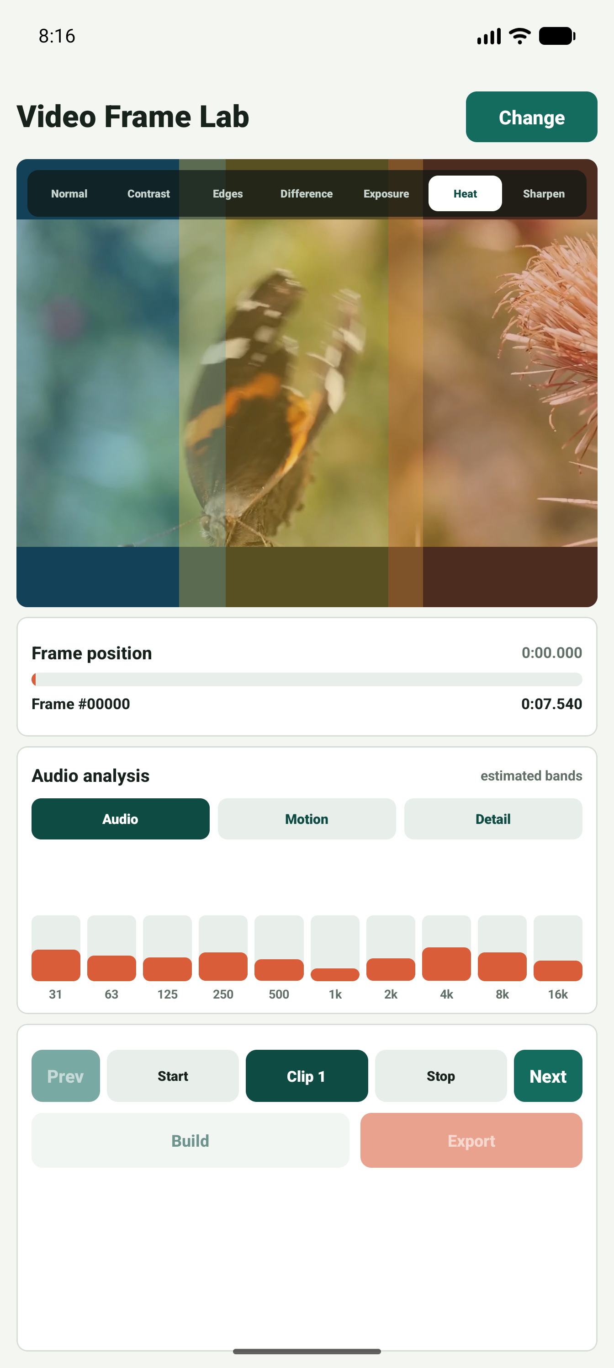
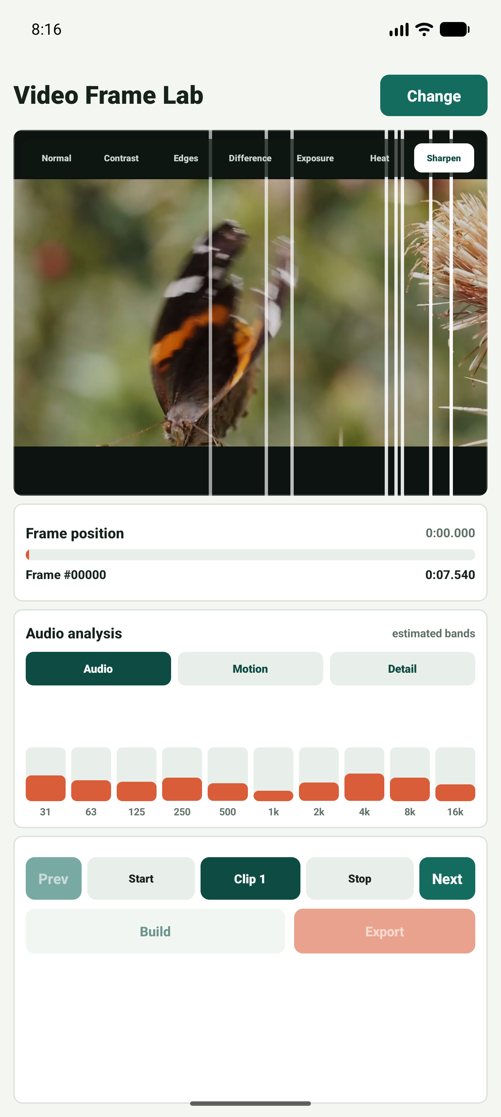
Video Frame Lab
Preview filters support visual inspection
Contrast filter
Edges filter
Exposure filter
Heat filter
Sharpen filter
Contrast, edge, exposure, heat, and sharpen modes make small frame differences easier to see while staying inside the same editing surface.
Submission feature screenshots | 5

Slide 6

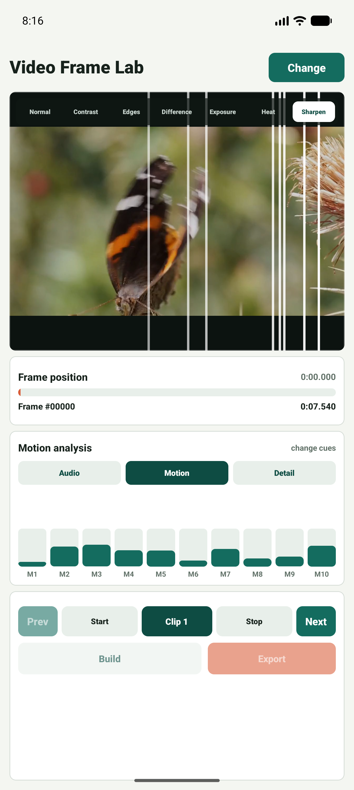
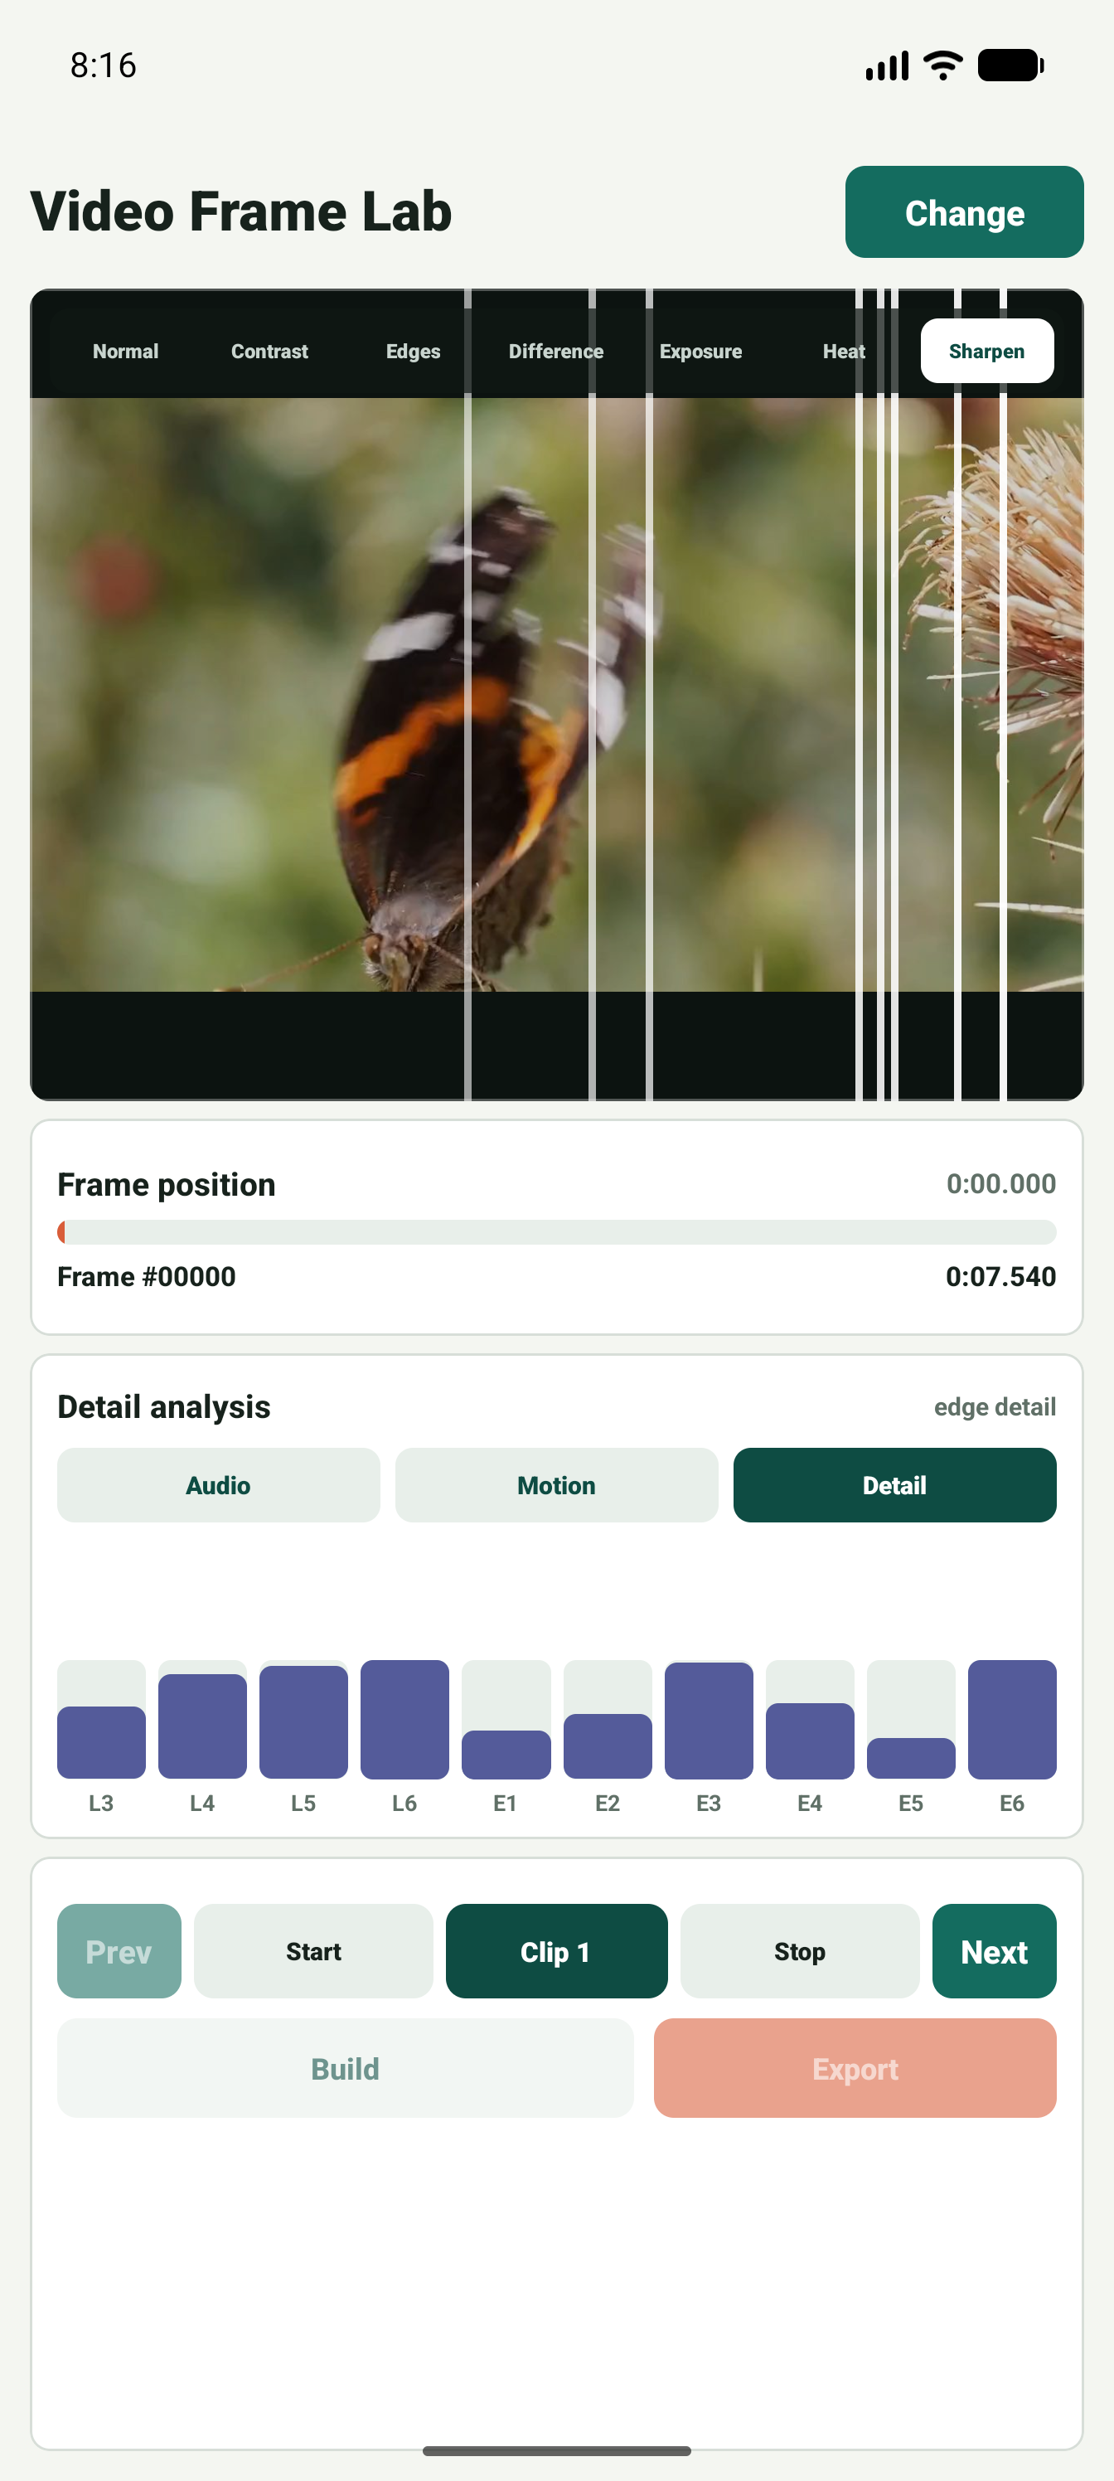
Video Frame Lab
Audio, motion, and detail analysis tabs
Audio bands
Motion cues
Detail bands
Submission feature screenshots | 6

Slide 7
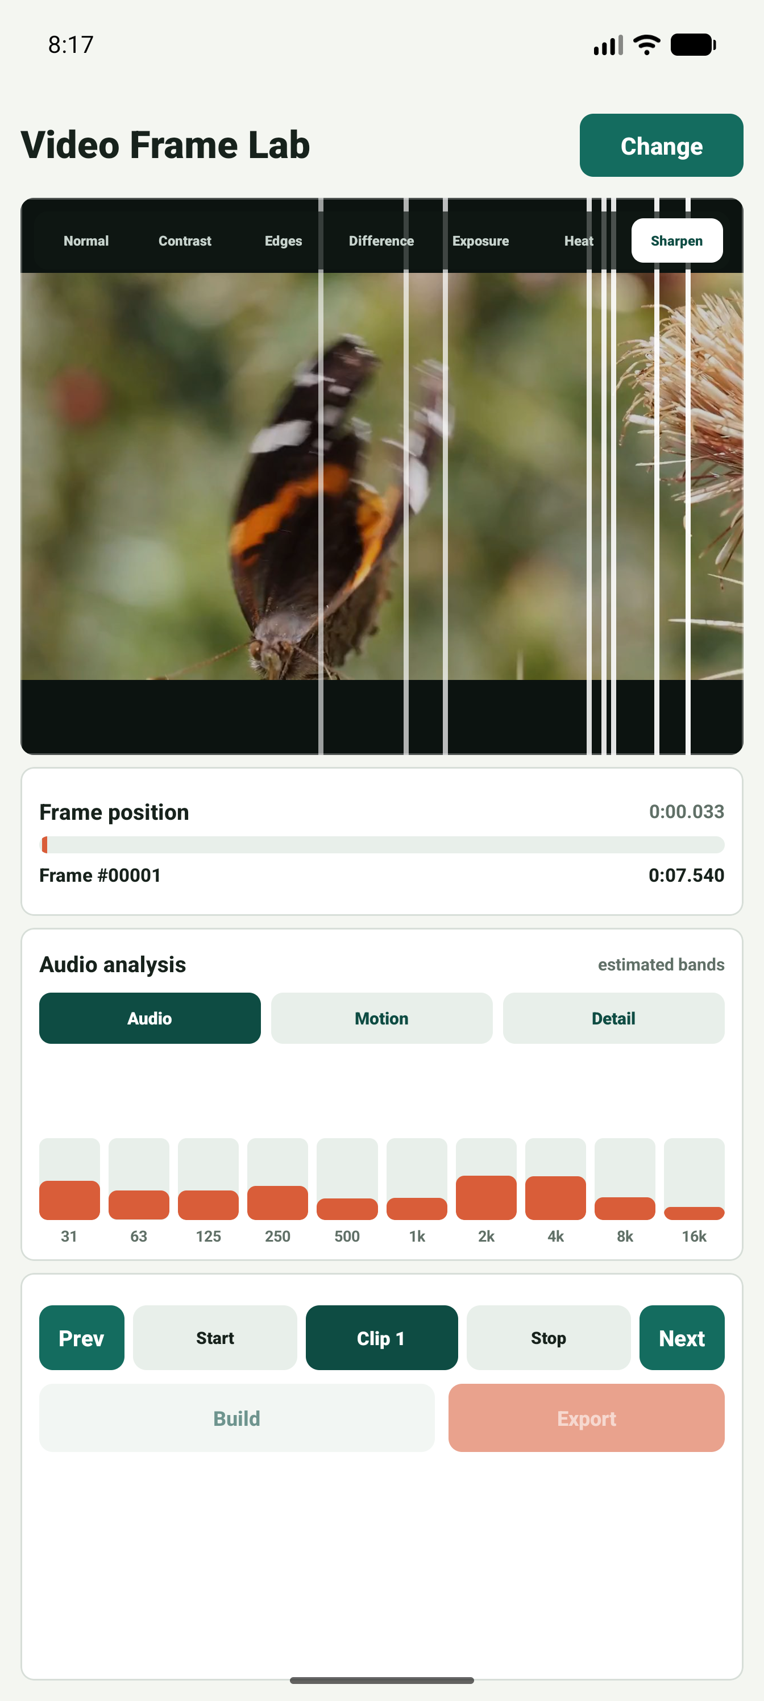

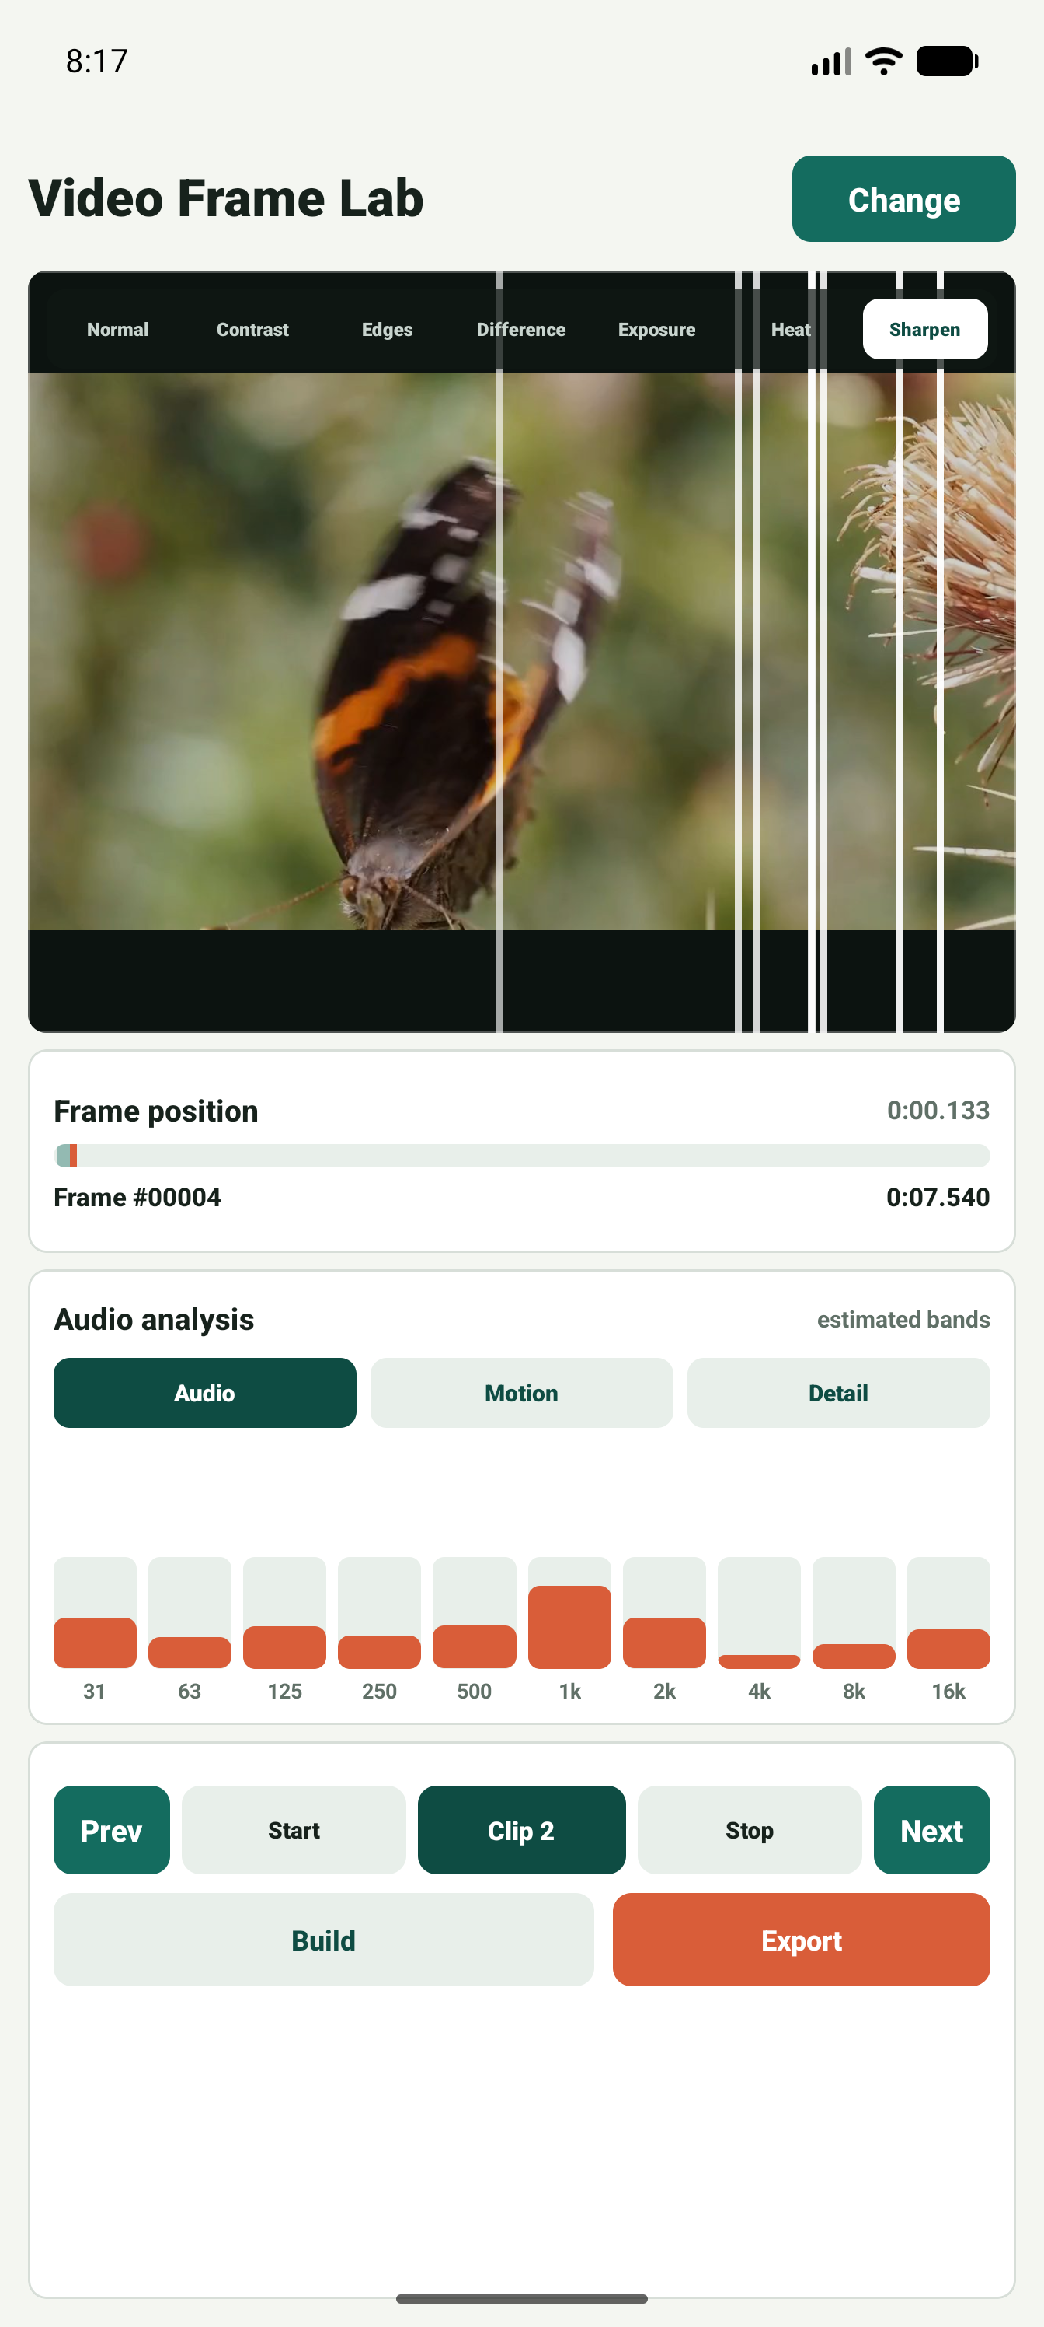
Video Frame Lab
Frame stepping and clip-point marking
Next frame
Start frame
Stop frame
Submission feature screenshots | 7

Slide 8
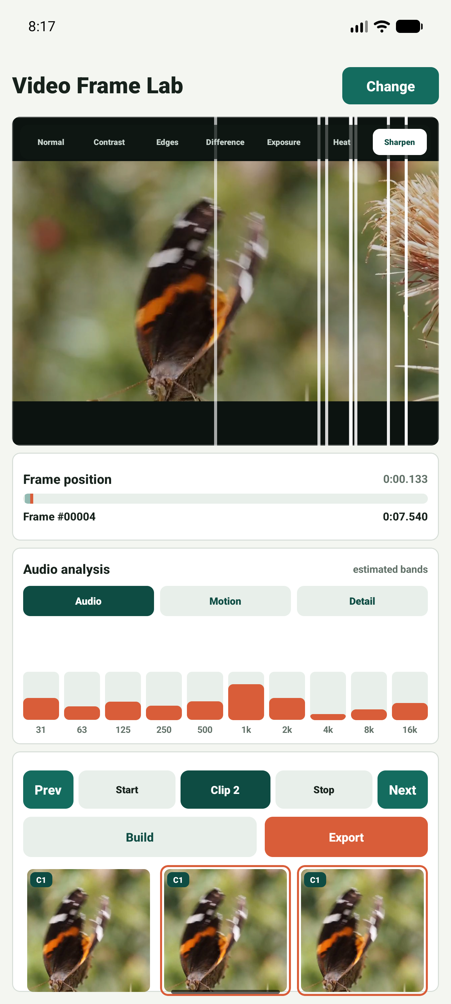
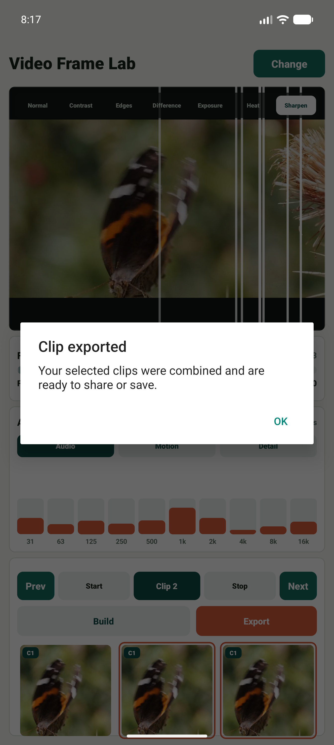
Video Frame Lab
Build a review strip, then export
Build creates thumbnail checkpoints for the selected clip.
Active frames are highlighted in the strip.
Export combines selected clips and confirms completion.
Frame strip
Export success
Submission feature screenshots | 8

Slide 9
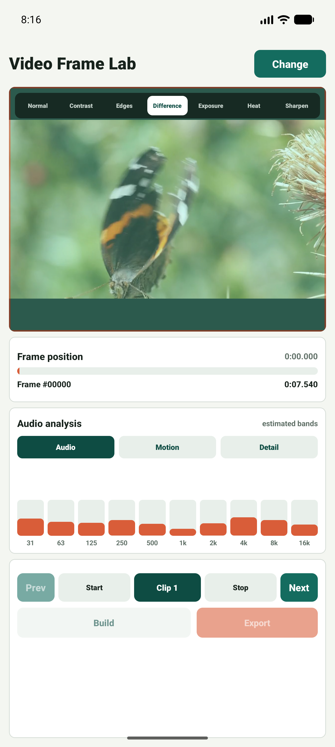

Video Frame Lab
Screenshot inventory included for submission review
1
2
3
4
5
6
7
8
9
10
11
12
13
14
15
16
17
18
19
20
20-screen contact sheet: disclaimer, empty state, picker, loaded video, filters, analysis tabs, frame controls, and clip workflow.
Submission feature screenshots | 9

